Slide 1

Quality Assurance Update
Risk Management Workshop
21st February 2018
1

Slide 2
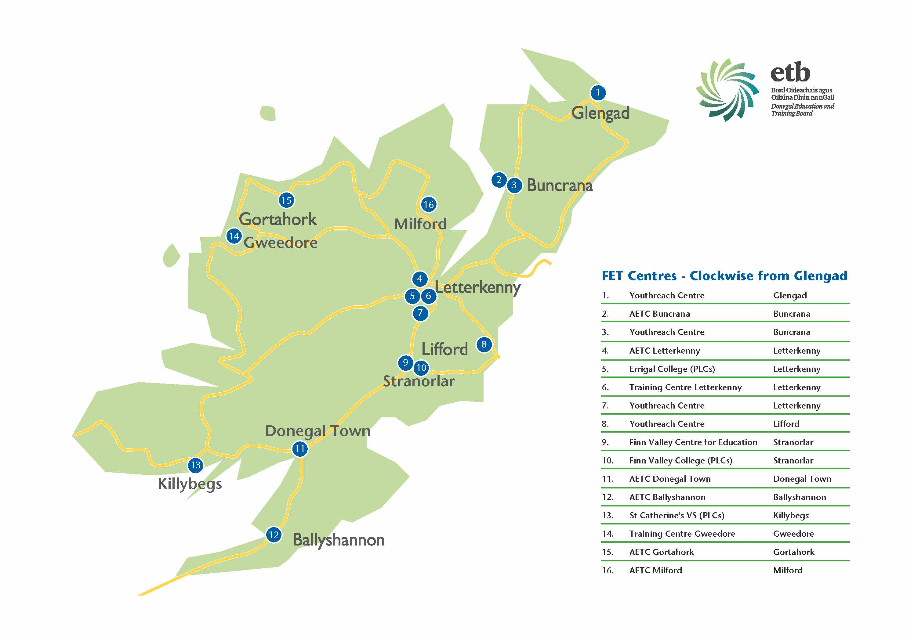
Donegal ETB- Provider owned Quality Assurance
Ethos:
Learner Focused
Integration
Community and Outreach Provision
24 QQI Requesting Centres active 2017
13 FET Centres
Multi Programme Centres/Integration
3 PLC Schools
1 Outdoor Education Centre
2

Slide 3
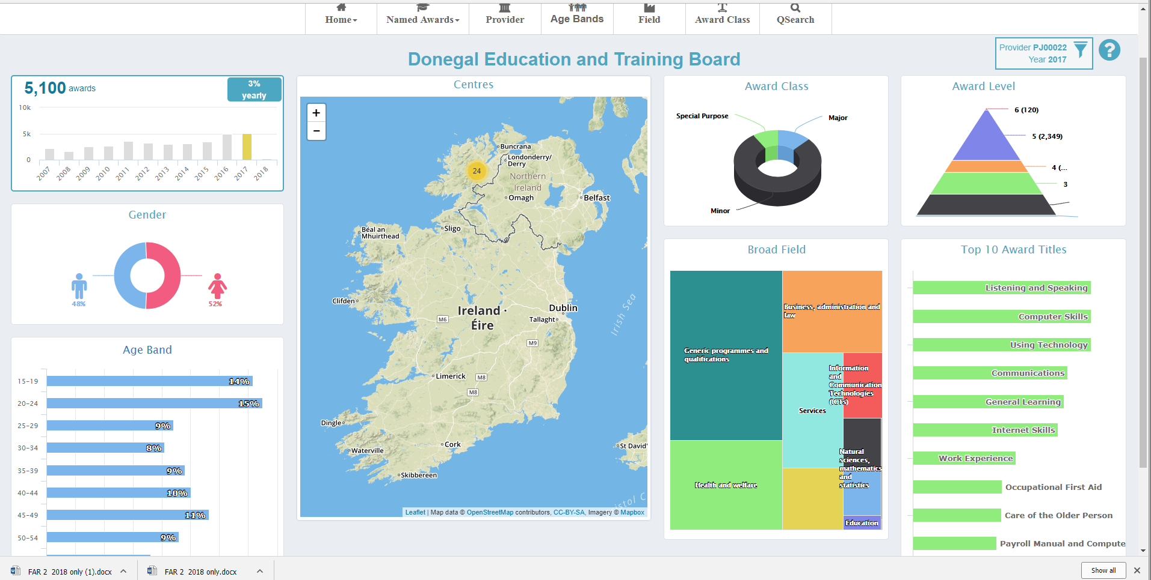
5,100 QQI Awards conferred to learners in 2017
327 Major awards at Level 5 were conferred
General Learning-Programme Level 2-106 Major awards were conferred.
http://infographics.qqi.ie/Provider/Details/PJ00022

Slide 4






Other Awarding Bodies and Quality Assurance Agreements
City & Guilds
ITEC
ICS Skills
Microsoft awards
Industry Awards
Vendor Awards

Slide 5
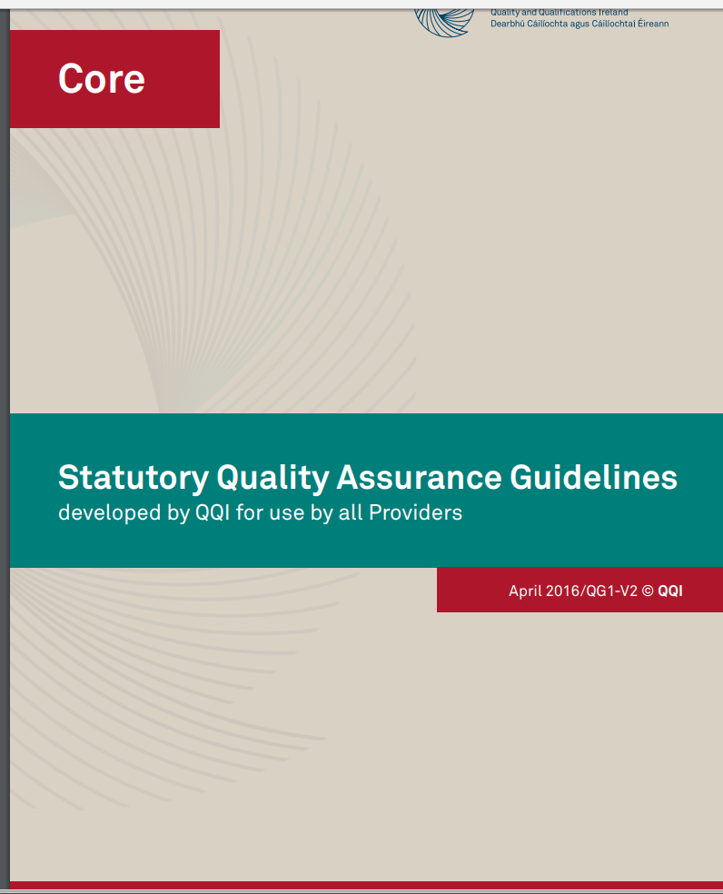
QQI Requirements for Re-Engagement- Provider owned Quality Assurance
Adoption of QQI statutory Core and Sector Specific
QA Guidelines
https://www.qqi.ie/Downloads/Core%20Statutory%20Quality%20Assurance%20Guidelines.pdf
11 Policy areas to be developed
Integration of QA Polices and Procedures for all ETB programmes
Publishing QA policy and procedures on public facing website
Legacy of Donegal ETB and TQAS systems
Legacy of former organisations shared programmes
Centralising and Integrating approaches to Assessment and Quality Assurance

Slide 6

Executive Self Evaluation Process-2017
ETBI Meetings
Terms of Reference
Meeting with ESE support staff
Governance Questionnaire
Feedback on current Governance
Planning for new Executive governance
QA working Group-Focus groups
FET Management-Focus Group
First draft on ETBI SharePoint
Discuss Draft with ESE external Support
Focus group on Draft with QA working Group
Final submission to QQI 22nd December

Slide 7
Quality Improvement Plan/Project-2018
QIP 5 Key Areas
New Governance structure
Programme development, Approval, Delivery and Review
Assessment and QA handbook
TEL
CPD
Engines to implement QIP:
QA Working Group
Coordinators Group
Stakeholder Feedback (Employers, Learners, Internal staff, Teaching staff)
Programme evaluation
Enterprise Engagement Group
SOLAS CPD strategy
SOLAS TEL Strategy
Guidance and Recruitment Service
ETBI Collaborative Projects

Slide 8
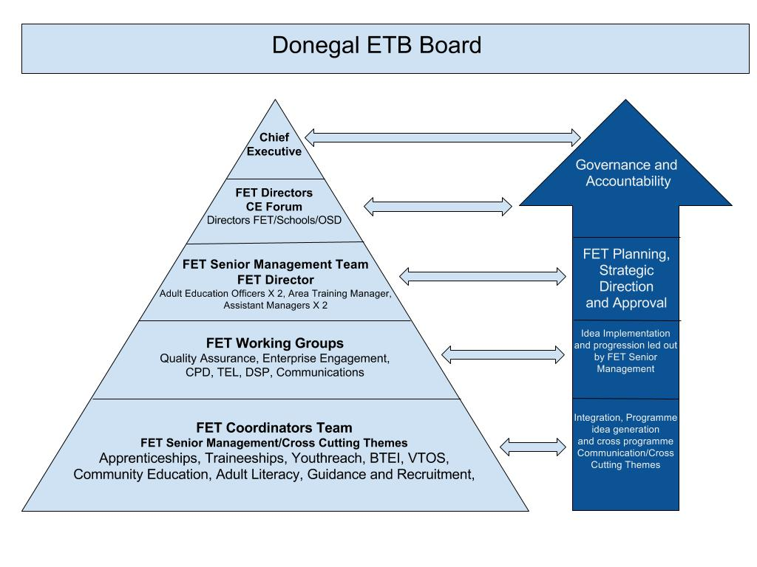
ETB Governance - Current
8

Slide 9
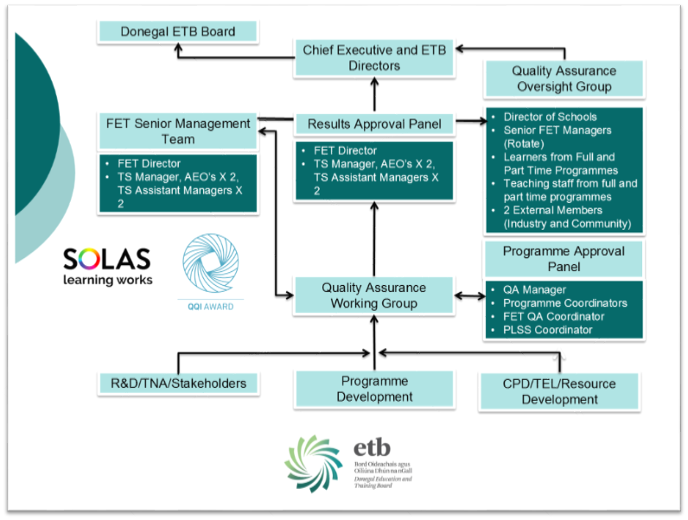
ETB Governance-Moving Forward
Objective Oversight

Slide 10
Continual Improvements- Moving Forward
EA Feedback=Centre/Programme improvement Plan
CPD Strategy
TEL Strategy/Working Group
Teaching and Learning Seminars (Cross Programme)
Programme Approval Panel
RPL For the Defence forces and new RPL framework
Integration of Guidance and Recruitment
Literacy utilisation by Training Services
Enterprise Engagement/Skills for Work
Community Education Research
Memo of Understanding, Progression pathways and dialogue with LYIT
FET Fair
Prospectus
ETB Website
Communications
Integrating Transversal Skills
DSP Interim Protocol Group
Relationship with Regional Skills Forum
Traineeship Development
Cross awarding body knowledge

Slide 11
Quality Assurance and Risk
ETB as a ‘provider’ of programmes of Education and Training
Accreditation and Recognition by stakeholders
Requirement to be responsive: Social Inclusion and Labour Market
Not lose sight of Learner focus and quality Teaching and Learning

